Slide 1
SVD in Recommender Systems
Aiyana Brown, Addie Gage, Sophia Rabbanian, Hriday Raj
Notes:
Good morning!
Our presentation is on Singular Value Decomposition used in Recommendation Systems
Before we get started, we’ll give some brief introductions
Name, pronouns, year, major

Slide 2




Real-Life Applications of SVD Recommender Systems
Notes:
Who here uses Tiktok?
How about Youtube, or Instagram?
Amazon?
Who goes on at least one of these apps everyday?
Recommender systems are everywhere!
All of these platforms are focused on providing content or products catered to your preferences. Each time you like an instagram post, watch a youtube video, or do some online shopping…
these apps keep track of your data, collecting and comparing it to all of their other users to find similarities and recommend content you might like.
Today we will talk about SVD is used recommender systems for streaming services, like Netflix.
With hundreds of users and movie offerings, how does Netflix decide what to put in your top 10?

Slide 3

Motivating Example
Our example SVD recommender system is similar to one a streaming service would use, like Netflix. Our matrix includes a few different users and movie offerings.
Motivating Question: Given a dataset of users and movie preferences, how can we use our current information predict unknown values? That is, predict which movies a user should watch if they don’t already have a preference.

Slide 4
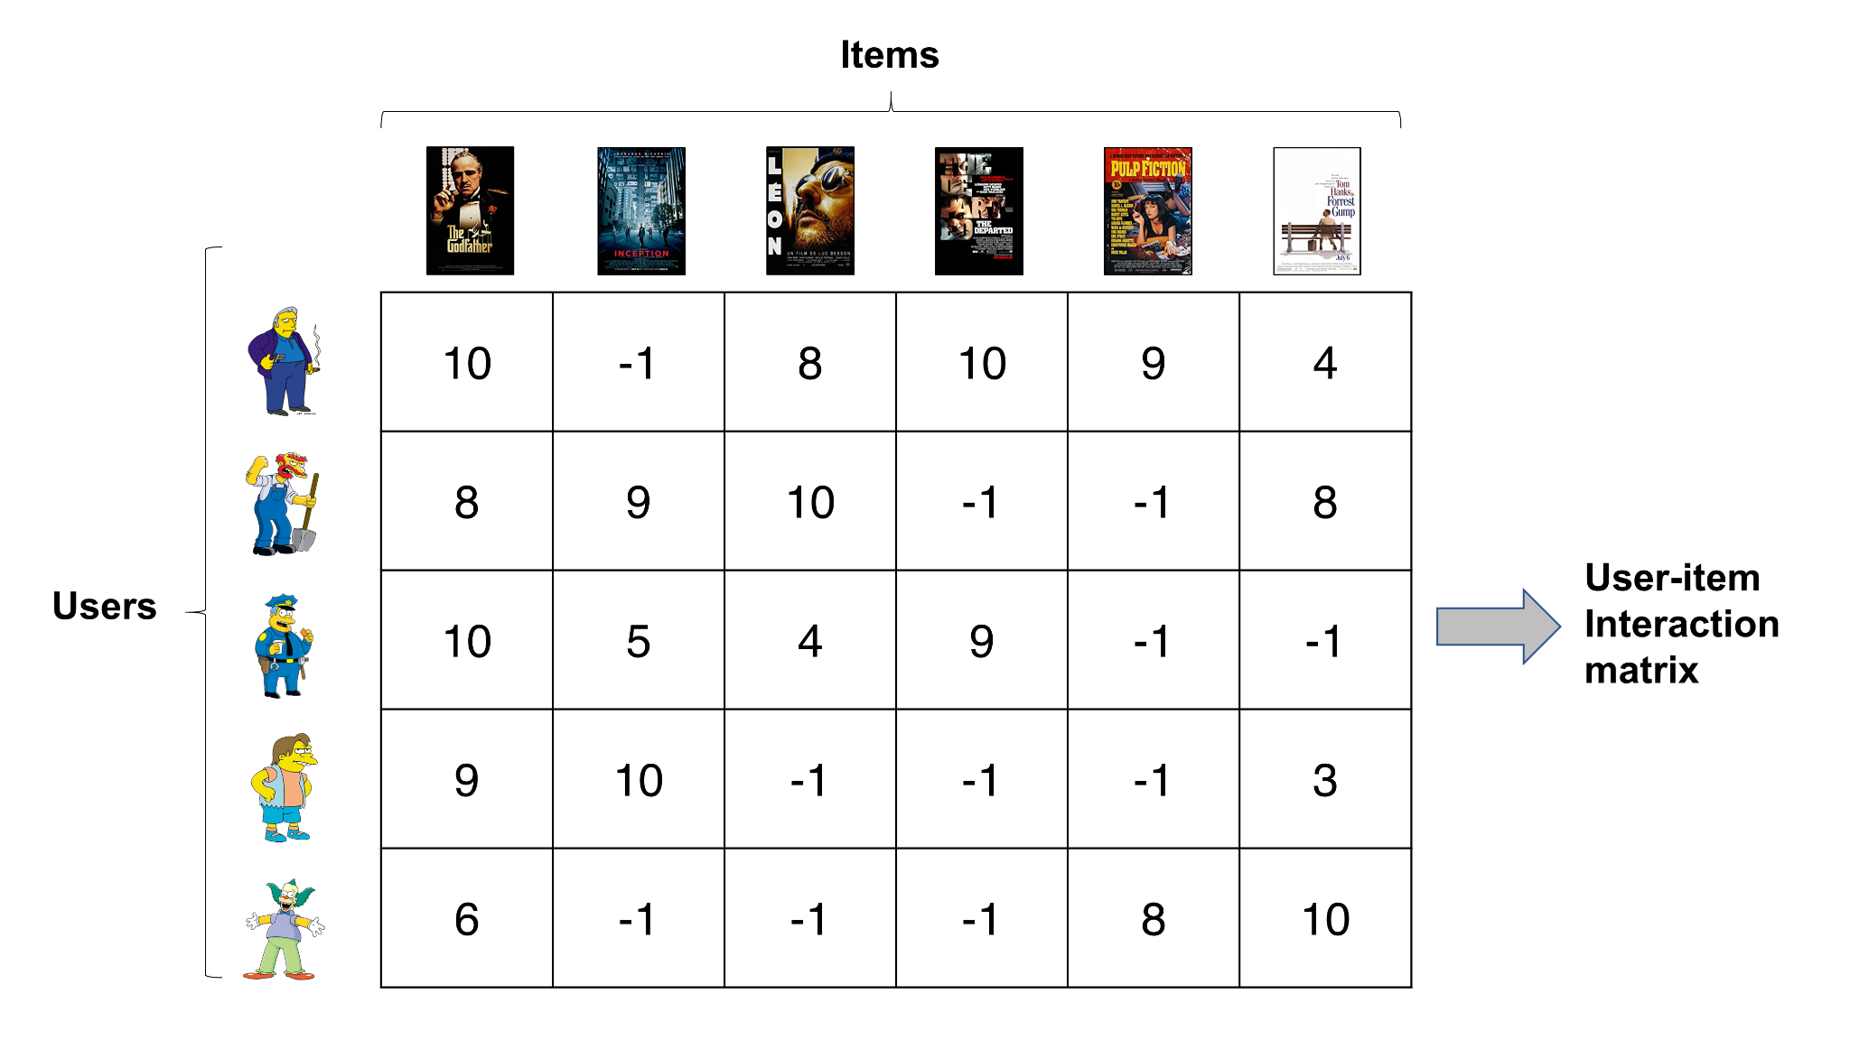
Motivating Example
Which movie should be recommended to Willie?
The Departed or Pulp Fiction?

Slide 5
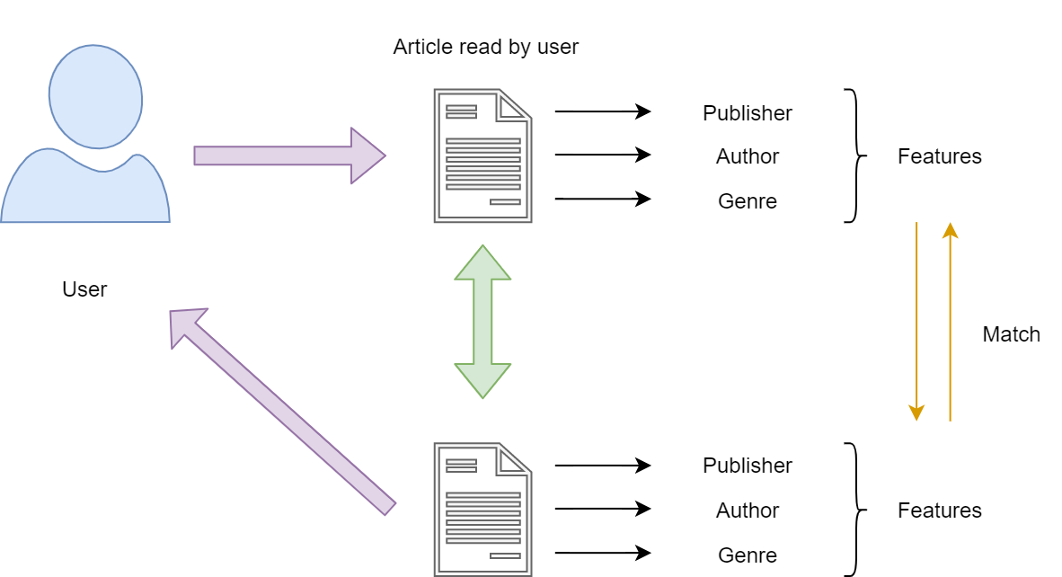
Content based filtering
Similarity of items are rated on the item’s features
If a user likes an item, another item with similar features will be recommended
Notes:
Addie
Let’s go over what content based filtering is. You have a dataset of items and their features. The similarity of items are calculated on their features, like publisher, author, and genre in articles. Then you are given a user that has read some of these articles. The system finds the most similar items to the ones the user has read and recommends them to the user.
http://datasciencehack.com/blog/2020/02/29/introduction-to-recommendation-engines/

Slide 6
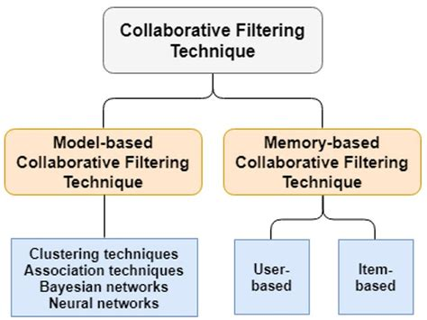
Collaborative filtering
Most popular method of recommendation
Model-based is a black box implementation, where you feed it data and train the model to make good recommendations
User-based memory recommendation judges how similar other users are based on a given user’s history
Item-based memory recommendation systems judges how similar items are based on a given user’s history
Notes:
Addie
Collaborative filtering is becoming a more and more popular method of recommendation, and this what the SVD will be used for. You are given a matrix where the users are the rows, and the items are the columns and the entries are either the user’s rating or a value of whether or not the user interacted with this item. This is called the user-item interaction matrix. In this example, we’ve got movie ratings by users, and -1 is if they haven’t rated it.
You have model based collaborative filtering, where you can train different techniques and networks to create recommendations based on the matrix. This is a black box way of implementing it so you don’t know what the model is doing to create recommendations. Some downsides of model-based filtering is that it can be computationally expensive to train the models and they are hard to update as you would have to retrain the model on any new information.
The memory-based filtering technique is what the SVD will be used for. In user-based recommendation, the similarity between users based on what items they bought are calculated to give recommendations. In item-based recommendation, the similarity between items are calculated based on the users. Item based recommendation can often be more efficient, as items are more static than users because users can change interests whereas items remain the same, and the number of items grow less rapidly than the number of users, so there are less similarities needed to compute than user-based recommendation.
https://www.researchgate.net/figure/Collaborative-filtering-techniques_fig2_340828169

Slide 7
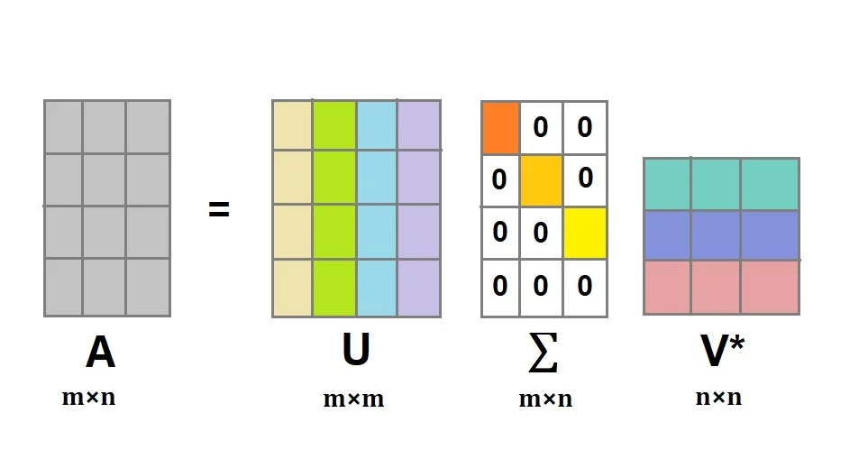
Recap on SVD
SVD breaks down large, complex matrices into smaller, easily usable ones!
Definition: Let A be an n x m matrix. Then there exists orthogonal matrices U and V and pseudo-diagonal matrix Σ such that:
All matrices have this decomposition!
A = UΣV^{T}
U = Left singular vectors
Σ = Singular values
V = Right singular vectors
Singular Value Decomposition
Columns of Matrix U (left singular vectors) form a basis for the user space
Columns of the Matrix V (right singular vectors) form a basis for the item space
They span all linear combinations of users and items
Notes:
Aiyana
Singular Value Decomposition
Why? The point of SVD is to break down complex matrices into smaller ones that still capture all of the original value. Our example uses a relatively small matrix so that it’s easier to understand…
but real-world companies that use movie recommendation systems, like Netflix for example, have TONS of data on their users and hundreds of movie offerings – so this technique of matrix decomposition and dimension reduction is especially helpful for gaining insight into user preferences
SVD is such a useful tool because it can be used to decompose all matrices, not just symmetric, square ones.
Definition: Any given matrix A can be decomposed into orthogonal matrices U and V and a pseudo-diagonal matrix Sigma… such that A = UΣV^{T}
^{POINT AT COLUMNS OF MATRICES}
^{U = left singular vectors}
^{V = right singular vectors}
^{Z = singular values}
Suppose the rows of A represent the users and the columns of A represent the items. Then in the orthogonal decomposition, the columns of the matrix U (left singular vectors) form a basis for the user space (all linear combinations of the users) and the columns of the matrix V (right singular vectors) form a basis for the item space.

Slide 8
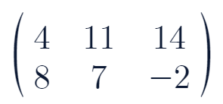
Lets perform SVD on our matrix →
Matrix A
What’s the first step?
Notes:
Now let’s go through an example! We have our original Matrix A…
What’s the first step? Ask Class
To perform SVD on a matrix, the first step is to find the inner product A^{T}A. This will give a symmetric matrix, which is needed for the next step of orthogonal diagonalization.
Then we need to find the right singular vectors and singular values. To do this orthogonally diagonalize the new matrix from A^{T}A. We recall the formula for this decomposition is (PDP⁻¹).
Find the eigenvalues and eigenvectors
Where, for a given matrix A, P = matrix of the unit eigenvectors, and D is a diagonal matrix of the eigenvalues. In SVD, P corresponds to V (the right singular vectors), and D corresponds to sigma, but the singular values are the sqrt of the eigenvalues
Now, we can find the left singular vectors (U). Each vector, using the formula:
U_{i} = 1 / σ_{i}(AV_{i})
To find the first left singular value = [1 / 1st singular value] * original matrix * 1st singular vector right singular vector

Slide 9
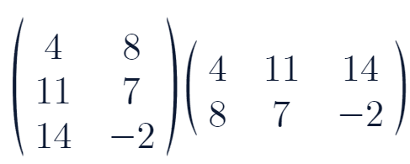
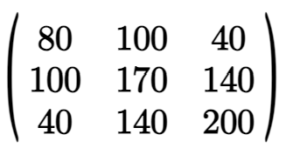
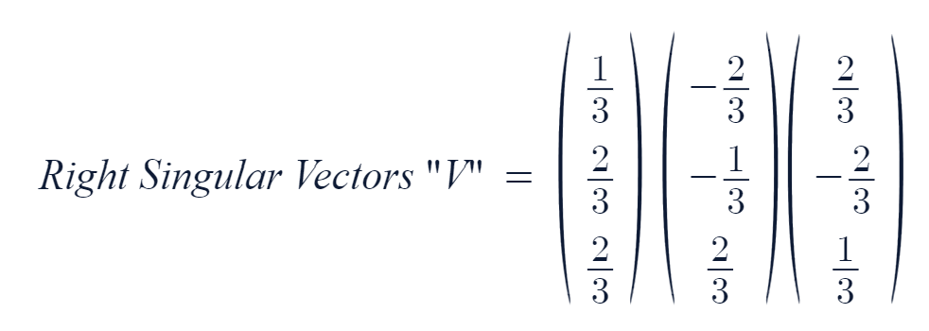
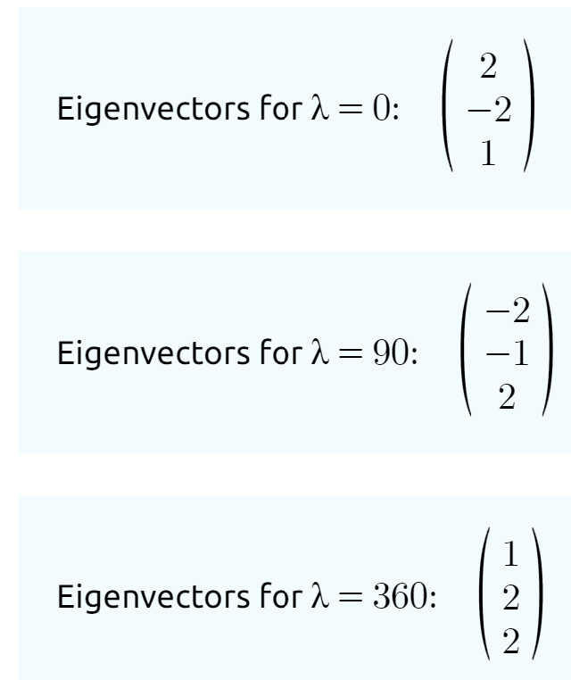
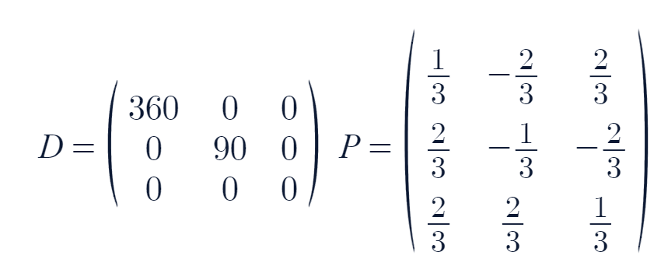
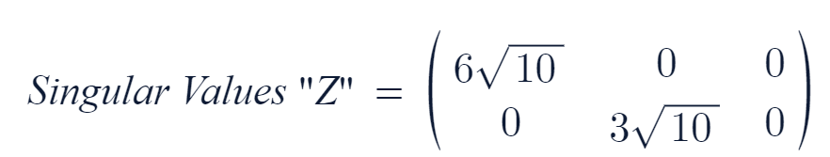
SVD Example
Find A^{T}A & orthogonally diagonalize
Matrix A
V = Right singular vectors: unit eigenvectors
A = UΣV^{T}
Σ = Singular values: √λ
A^{T}A =
=
Notes:
Aiyana
To perform SVD on a matrix, the first step is to find the inner product A^{T}A. This will give a symmetric matrix, which is needed for the next step of orthogonal diagonalization. Note, PDP-1 = PDPt
Then we need to find the right singular vectors and singular values. To do this orthogonally diagonalize the new matrix from A^{T}A. We recall the formula for this decomposition is
PDP⁻¹ – where D is an orthogonal matrix made of the unit length eigenvectors and D is a diagonal matrix of the eigenvalues.
Find the eigenvalues and eigenvectors
Normalize the eigenvectors to length 1 ( 1 / length of vector → 1/√(x1+x2+xn) )
In SVD, P corresponds to V (the right singular vectors), and D corresponds to sigma
but the singular values are the sqrt of the eigenvalues

Slide 10
What’s the next step?
Notes:
So we have the singular values and right singular vectors… now what do we do? Ask Class
Now, we can find the left singular vectors (U). Each vector, using the formula:
U_{i} = 1 / σ_{i}(AV_{i})
To find the first left singular value = [1 / 1st singular value] * original matrix * 1st singular vector right singular vector

Slide 11
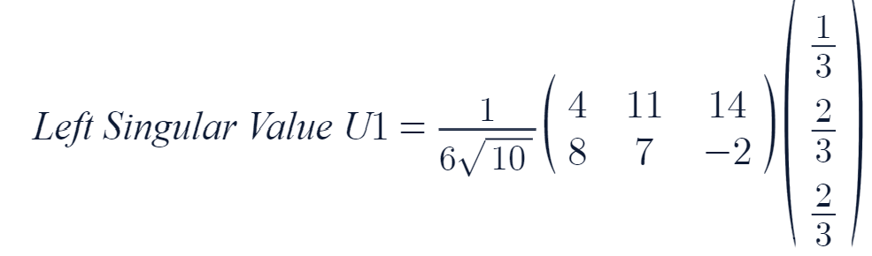
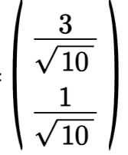
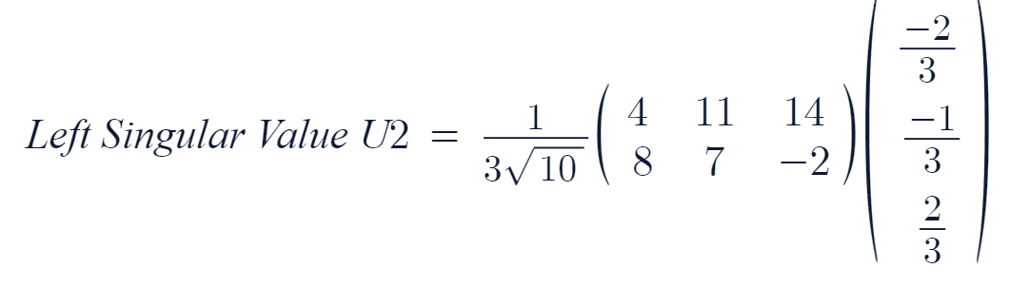
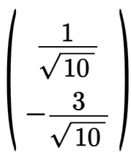
SVD Example
Find A^{T}A & orthogonally diagonalize
V = Right singular vectors: unit eigenvectors
Σ = Singular values: √λ
Last Step!
Left singular vectors: U_{i} = 1 / σ_{i}(AV_{i})
Matrix A
=
Vector
=
Vector
Notes:
Aiyana
Now, we can find the left singular vectors (U). Each vector, using the formula:
U_{i} = 1 / σ_{i}(AV_{i})
To find the first left singular value = [1 / 1st singular value] * original matrix * 1st singular vector right singular vector

Slide 12
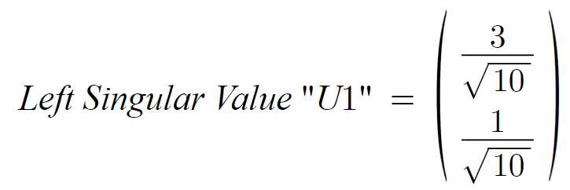
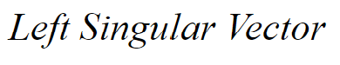
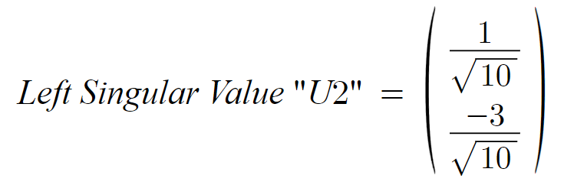
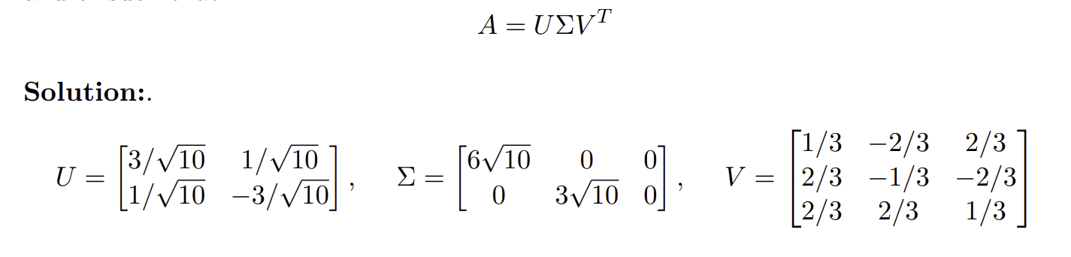
SVD Example A = UΣV^{T}
Matrix A =
Notes:
Aiyana
Putting it all together!

Slide 13
Motivating Example
Which movie should be recommended to Willie?
The Departed or Pulp Fiction?

Slide 14
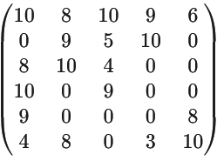
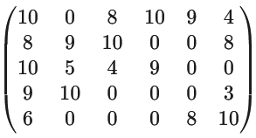
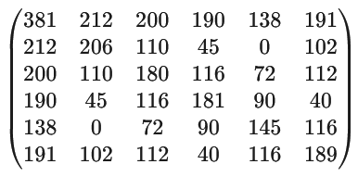
SVD with our dataset A^{T}A
𝞼₁ = 29.47831895
𝞼₂ = 14.06486849
𝞼₃ = 12.23282051
𝞼₄ = 7.8110385
Notes:
Hriday

Slide 15
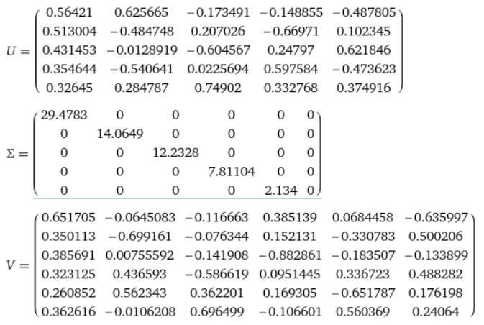
SVD with our dataset UΣV^{T}
Notes:
Hriday

Slide 16
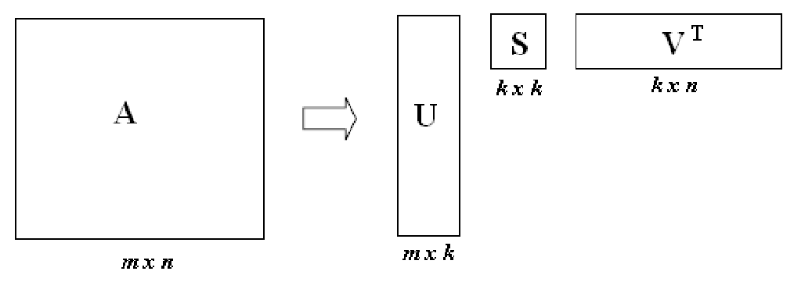
Dimensionality Reduction
From SVD, you reduce U, Σ, and V by keeping the first k singular values in Σ and removing r-k columns from U while removing r-k rows from V.
By performing dimensionality reduction, we increase the computational efficiency of the recommender system and this also filter out noise.
Σ
Notes:
Addie

Slide 17
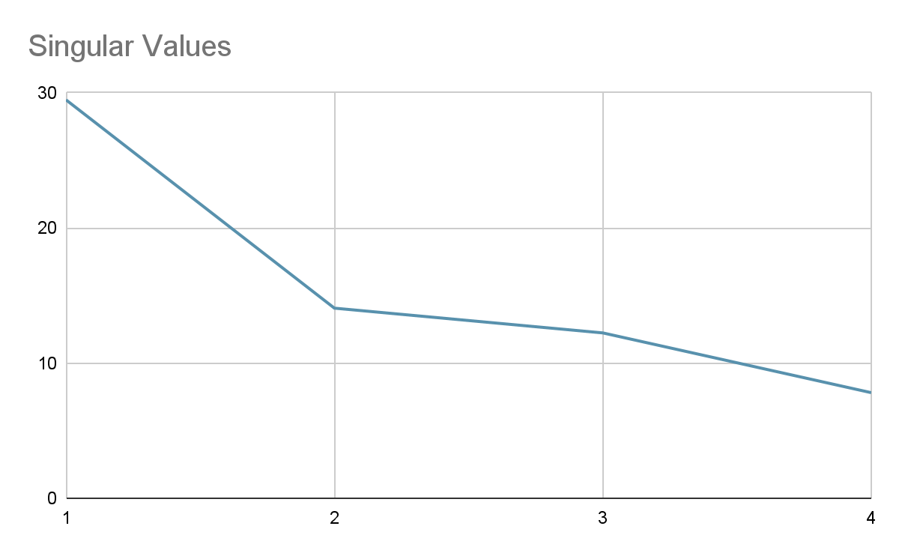
Dimension Reduction With Our Movie Dataset
k = 2
Not much difference in values!
𝞼₁ = 29.47831895
𝞼₂ = 14.06486849
𝞼₃ = 12.23282051
𝞼₄ = 7.8110385
Notes:
Addie
When there’s too much noise within a dataset, makes computation easier, less intensive, less expensive.
In this plot, you can see that after k=2, there is not much difference between values, so we chose to dimensionally reduce to k = 2.

Slide 18
Dimension Reduction with our dataset
Notes:
Addie
Essentially, all of the values that are not boxed would not be included in the computation
Helps filter out insignificant factors in the data.
Improves generalization of patterns in the data to give better recommendations
Overall, dimensionality reduction in SVD enhances the effectiveness, efficiency, and interpretability of recommender systems by capturing the essential structure of the user-item interaction data in a lower-dimensional space.

Slide 19
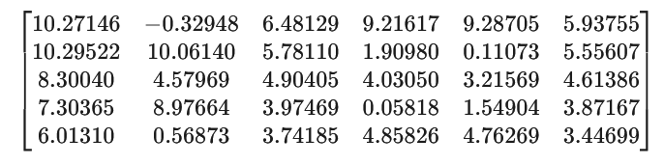
Dimensionally reduced matrix

Slide 20
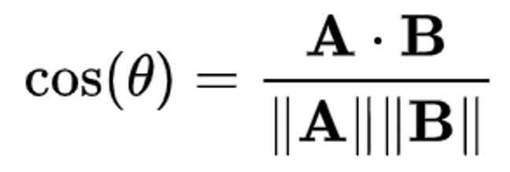
User-based Similarity
Item-based Similarity
Reduced matrix V_{k} is used
Each row = 1 item
Items do not change as frequently as users do :
Available for pre-computation
Better run-time performance
Comparing two items (rows) in the V_{k} matrix:
Cosine-based similarity
Euclidean distances in k-dimensional space
Reduced matrix U_{k} is used
Each row = 1 user
Comparing two users (rows):
Cosine-based similarity
Euclidean distances in k-dimensional space
Cosine-based similarity: Suppose a, b are two users
Measure similarity between users a and b using:
Notes:
Sophia
Our next steps are user and item based similarity
User based similarity looks at how users similar to User X have rated item Y, and then make assumptions on how User X will rate an item Y based on the users most similar to user X
This information is stored in the U_{k} matrix where each row represents a user.
The rows of the matrix are then compared to each other to determine how similar two users are to each other.
The techniques used to compare users: cosine-based similarity and euclidean distances in k-dimensional space.
So suppose a and b are two users.
Formula on board, written different when we learned it.
Item based similarity is very similar
It looks at all the items rated by user x, to make a prediction about how user x will rate item Y using the items most similar to item Y.
Use V_{k} matrix where each row is an item
We use the same techniques to measure similarity

Slide 21
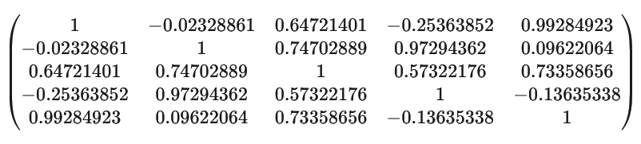
Cosine Similarities between users
Notes:
In our problem, we decided to use cosine based similarity of users, and you can see our similarity matrix here
This makes sense in context……

Slide 22
Now that we have our dimensionally reduced matrix and cosine similarity matrix, what’s next?

Slide 23
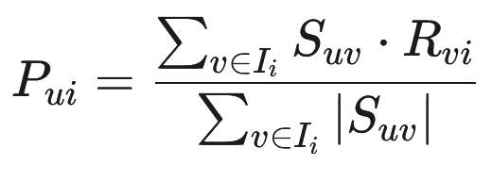
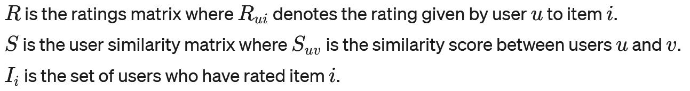
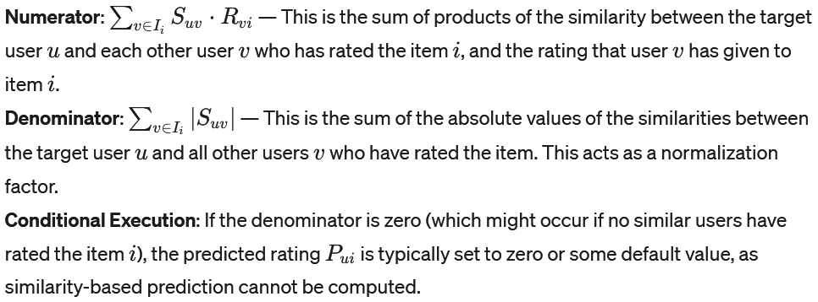
Calculating Predicted Ratings
Notes:
Hriday?

Slide 24
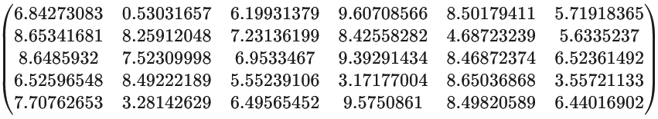
Predicting ratings- our data
We use these two matrices to
get our final matrix:

Slide 25


Final Predicted Ratings
Which movie should be recommended to Willie?
The Departed or Pulp Fiction?
The algorithm suggests The Departed would be a better movie for Willie

Slide 26
Benefits of SVD
vs
Limitations
Simplifies datasets, making patterns more discernible and calculations faster.
Enhances the accuracy of predictions, tailoring recommendations to individual preferences.
SVD complexity can strain resources, particularly with very large data sets
Struggles with new users/items (cold start) and rapidly updating preferences.
Notes:
Sophia

Slide 27
Sources
Our main source:
Osmanlı, O. N. (2010). A singular value decomposition approach for recommendation systems [M.S. - Master of Science]. Middle East Technical University. https://open.metu.edu.tr/handle/11511/19640
Others of note:
Enhancing Recommender Systems with NLP-based Biased
Singular Value Decomposition | Semantic Scholar
Recommender systems: a novel approach based on singular value decomposition | Semantic Scholar
Recommendation Algorithm with SVD - Jake Tae
Recommender System — singular value decomposition (SVD) & truncated SVD | by Denise Chen | Towards Data Science
https://realpython.com/build-recommendation-engine-collaborative-filtering/
Notes:
Sophia

Slide 28
Thank you!

